Slide 1
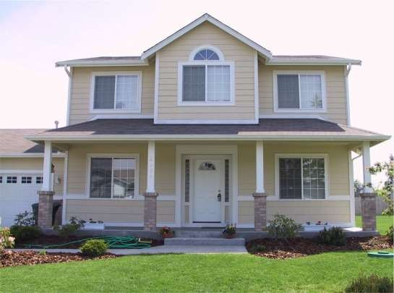
Real Estate Price Prediction
Source Dataset from Kaggle

Slide 2
Introduction
About Real Estate
About Dataset
Insights of Dataset
Exploratory Data Analysis
Agenda

Slide 3
Our goal for this project is to use regression and classification techniques in order to estimate the sale price of a house in New Taipei City, Taiwan given the feature and pricing data for around 414 houses sold within one year.
Introduction

Slide 4
A real estate business is a business entity that deals with the buying, selling, management or investment of real estate properties. According to The Balance, real estate is “the property, land, buildings, air rights above the land and underground rights below the land.”
Residential real estate includes undeveloped land, houses, condominiums, and townhouses. The structures may be single-family or multi-family dwellings and may be owner-occupied or rental properties.
About Real Estate

Slide 5
About Dataset
Our dataset comes from a Kaggle competition.
Our dataset contains house sale prices and its features for homes sold in Taipei City, Taiwan between 2012 and 2013.
Taipei city is the most populous county in Taiwan and is included in the metropolitan statistical area. The county is considered the most populous county in the China.
There are 414 observations in the dataset.
There are 7 total attributes in the dataset, We are planning to use 4 attributes to predict all attributes except for date, latitude and longitude.

Slide 6
Insights of Real Estate Price Prediction
There are 414 observations in the dataset.
In which ‘price’ is the dependent variable on the other parameters/feature that is age, Metro station, shops nearby the house.
As the data is continuous and supervised (labelled) data set we can apply linear regression to get the price predicted.
We can also include a categorical column for distance from Metro station and also nearby by shops to the house.
For example if we include the categorical variable, we can predict the house nearby Metro station, and stores are shops.
If the house is nearby Metro station and Stores then we can see the price of the home is high as per the data set.

Slide 7
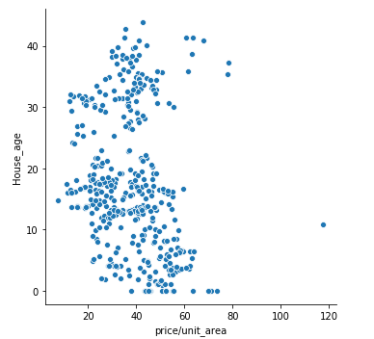
"Price of house is between 20 to 60 where the house age is between 0 to 20 years"
EXPLORA-TORY DATA ANALYSIS

Slide 8
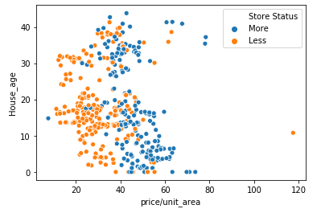
"The price value increases as the no of stores increases. From the graph less no of stores are crowded than more number of stores"
EXPLORA-TORY DATA ANALYSIS

Slide 9
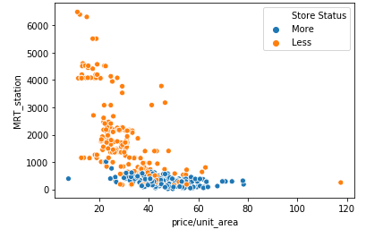
Stores are more where the distance between house and metro station is less than 1000m
EXPLORA-TORY DATA ANALYSIS

Slide 10
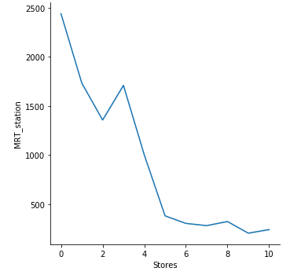
"No of stores is less if the distance from Metro station is more from house"
EXPLORA-TORY DATA ANALYSIS

Slide 11
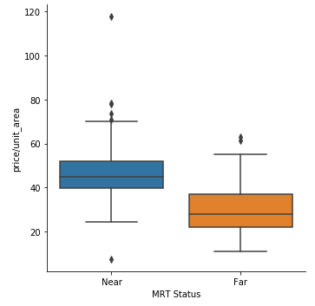
As the distance from Metro station increases the price of the house decreases.
EXPLORA-TORY DATA ANALYSIS

Slide 12
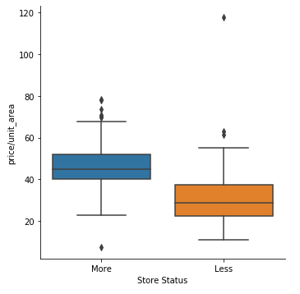
"The price is more where the no. of store are more and price value is less where there is less no.of stores"
EXPLORA-TORY DATA ANALYSIS

Slide 13
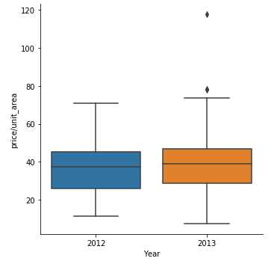
"The price is equally distributed in both the year but there are some outlier in 2013
EXPLORA-TORY DATA ANALYSIS

Slide 14
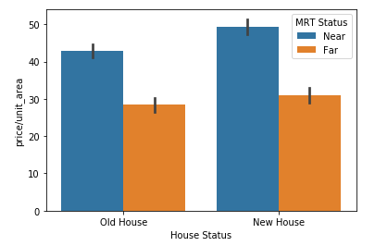
"Price of old house is less compared to price of new house and also as MRT stations are nearby"
EXPLORA-TORY DATA ANALYSIS

Slide 15
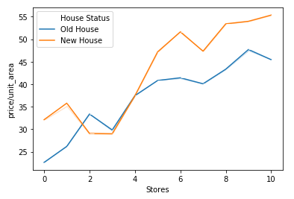
“Most of the new houses are located where the number of stores are greater than 5”
EXPLORA-TORY DATA ANALYSIS

Slide 16
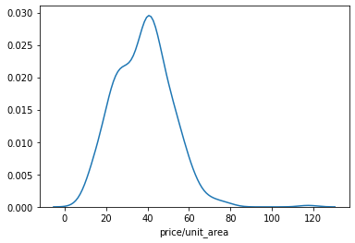
"The price of the house is right skewed and the deviation of the price from mean is towards right of the graph'
EXPLORA-TORY DATA ANALYSIS

Slide 17
"The price of the house is right skewed and the deviation of the price from mean is towards right of the graph'
EXPLORA-TORY DATA ANALYSIS

Slide 18
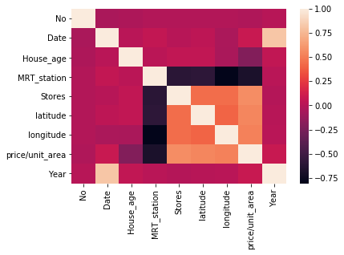
Price of house is shows around 50% correlation to Stores, Latitude and longitude
EXPLORA-TORY DATA ANALYSIS

